Slide 1

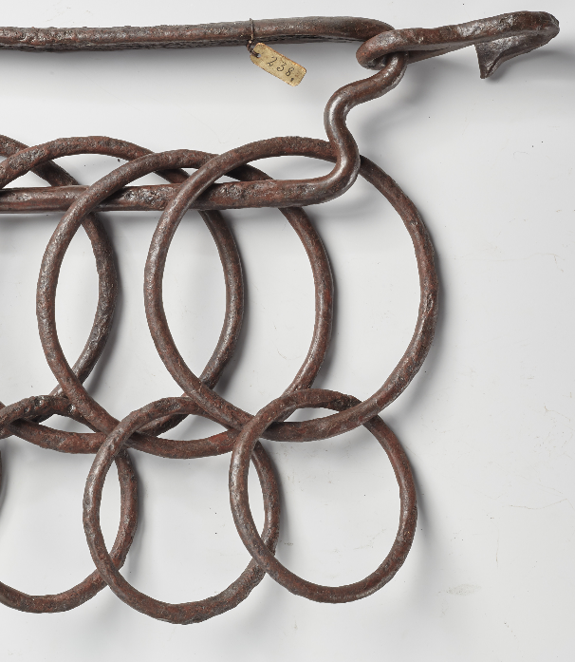

INTER-Action: Linking Practice and Defining Methods in Heritage Studies
​
CHNT 11.11.2022
C238 ‘Rattle’ from Vågå. Photo: Ulla Schildt, KHM

Slide 2
3D seminar: Active use of 3D models 7. – 8.9.2023
Nicolo Dell'Unto: BItFROST. 3D-models prepared for research and teaching. Make a selection, add focus points and share.
Paola Derudas: Excavations "ON AIR". A multi-dimensional web 3D platform for supporting field archaeology".
Rosie Campbell: Integrating large-scale field photogrammetry and 3D GIS: Excavations at Dhaskalio.

Slide 3
DIRE – Data Visualization Remote Access
DIRE vil etablere en Virtual Desktop Infrastructure (VDI) for forskergrupper ved Universitetet i Oslo og implementere denne i eksisterende og nye forskningssamarbeid ved universitetet.
DIRE gir også grunnlag for internasjonalt samarbeid gjennom deling av regnekraft

Slide 4
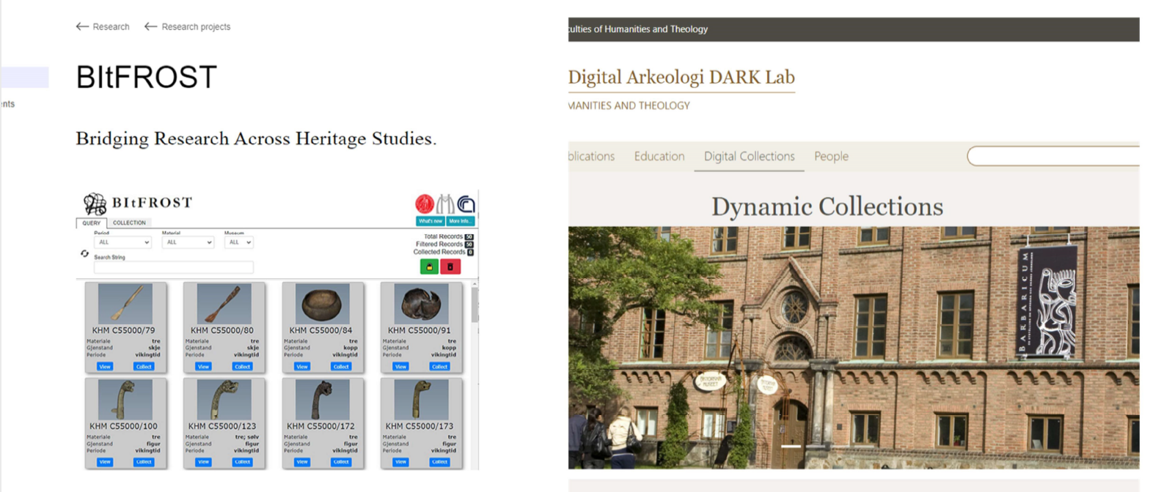

Slide 5
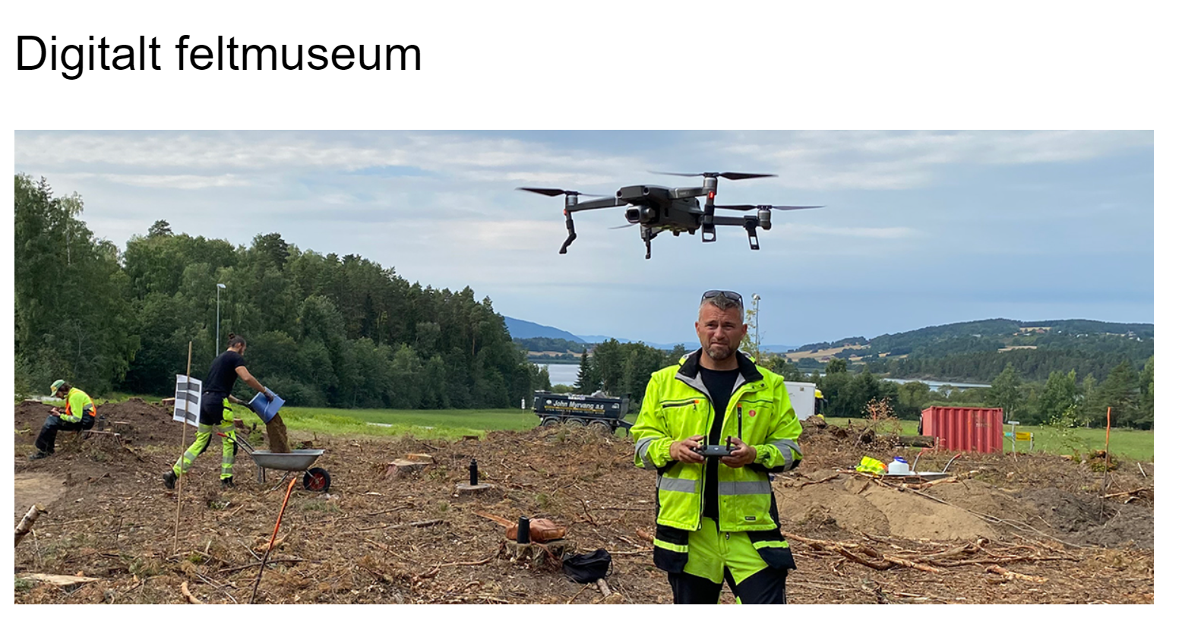

Slide 6
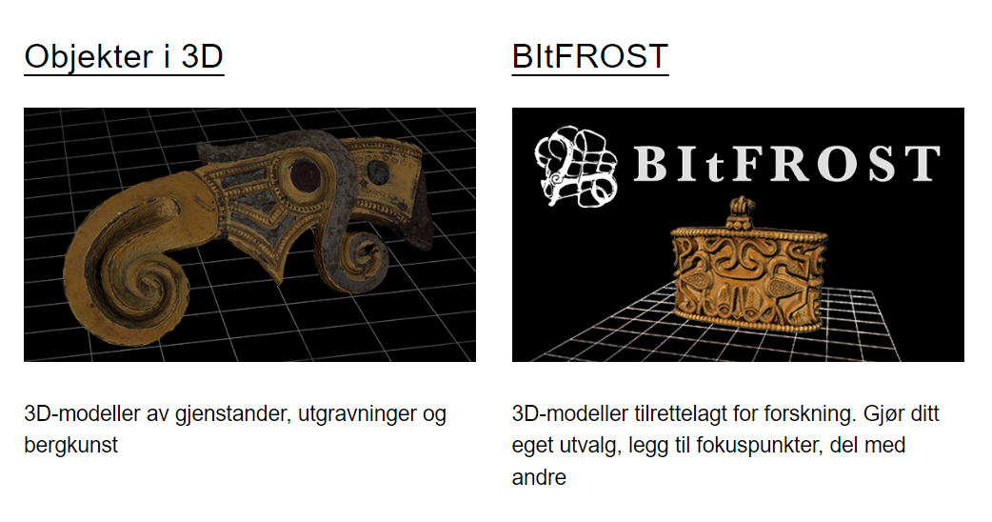

Slide 7
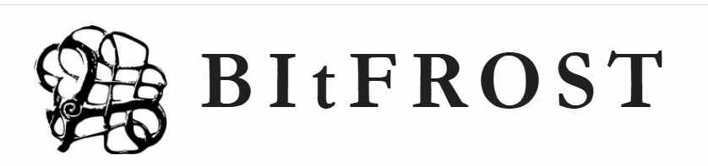
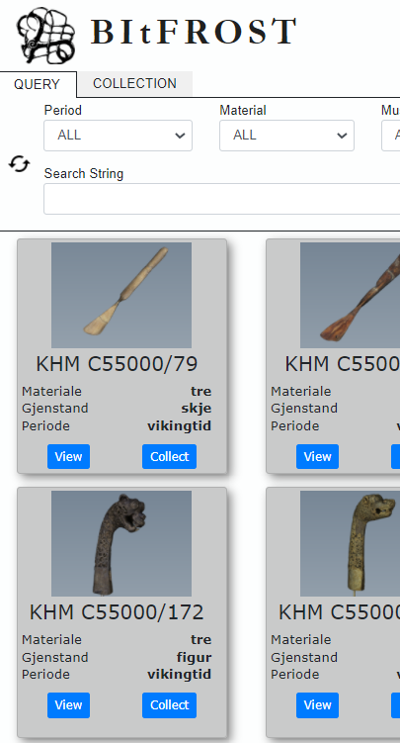
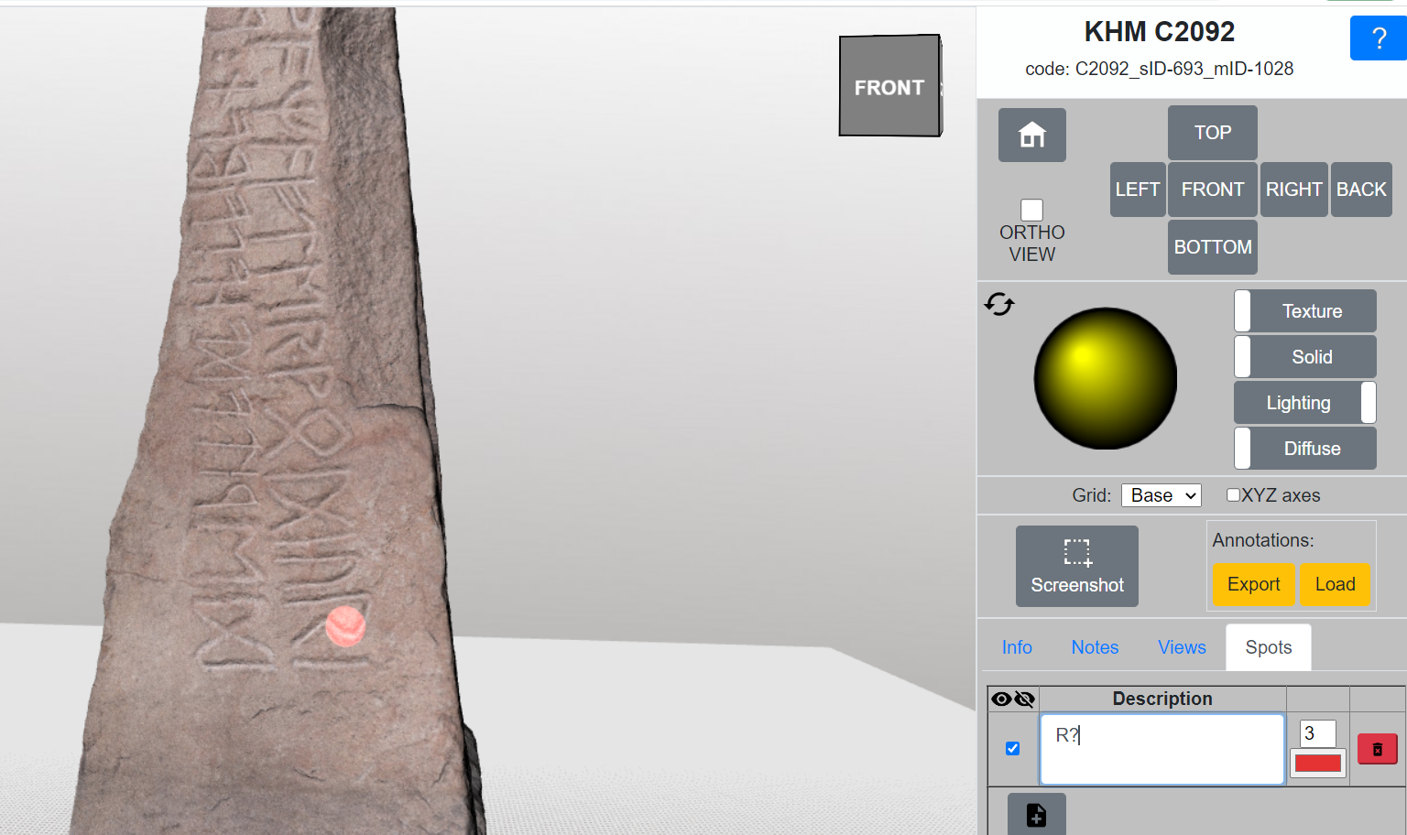
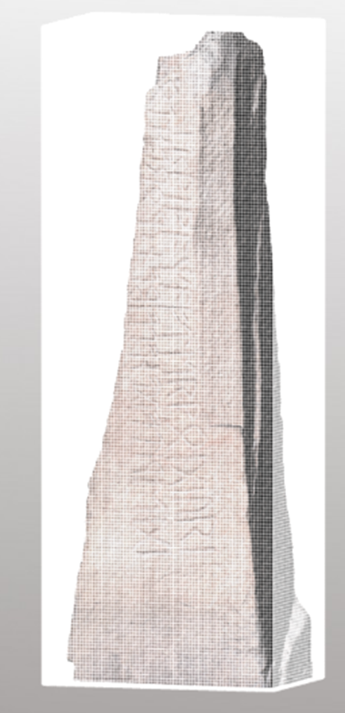
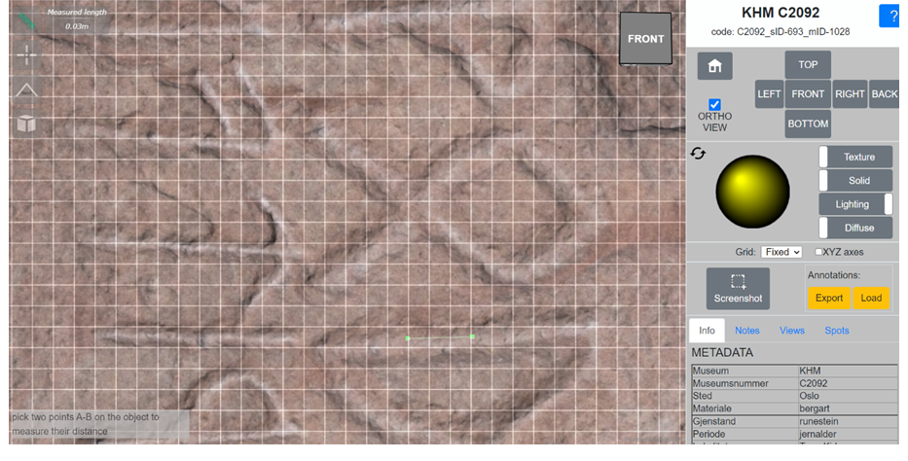
BItFROST. Collections, note taking, measuring and bounding box tools. Featured model the Thune stone photogrammetry by Letizia Bonelli.

Slide 8
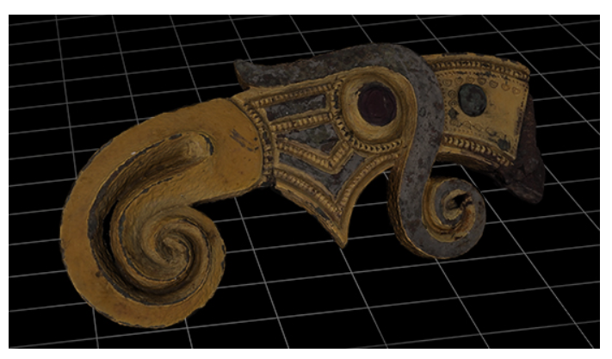
Ui3D: Understanding and Immersion in 3D
make the tools developed by the infrastructure BItFROST and the large investments in 3D documentation at KHM more accessible for researchers at UiO. It will build networks integrating infrastructure developers, researchers and lecturers.
cooperate with the 3D documentation group at KHM to promote critical thinking concerning reuse and production of 3D models to enhance digital competence.
provide access to the university's collections to a range of disciplines by delivering a base for research and teaching materials.
highlight the University of Oslo's leading position in the field, through contributions to open-access learning platforms and national and international conferences.
provide opportunities to make AR/VR equipment and the Sitsim AR editor available for innovative learning methods.
arrange seminars and at least four workshops over the second and third year.

Slide 9
Virtual Worlds in Teaching Archaeology
Erasmus+ Cooperation Partnerships 2023
- Utvikling, testing og klargjøring av nye metoder
- Utvikling av moderne, virtuelle læringskonsept for arkeologi
- Standardisering og klargjøring av 3D-data og VR-miljøer

Slide 10
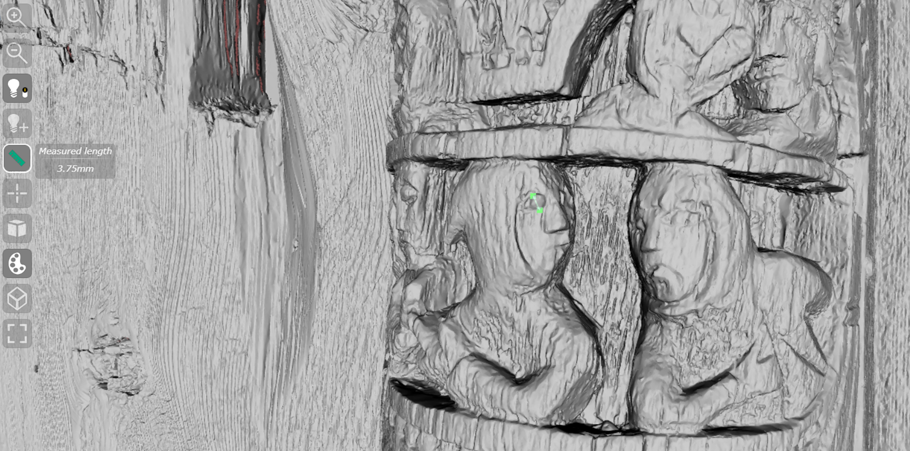
Structured light Scanning-based model of Nesland portal, C1542. Technician: Bjarte Aarseth. Museum of Cultural History, University of Oslo.

